Slide 1
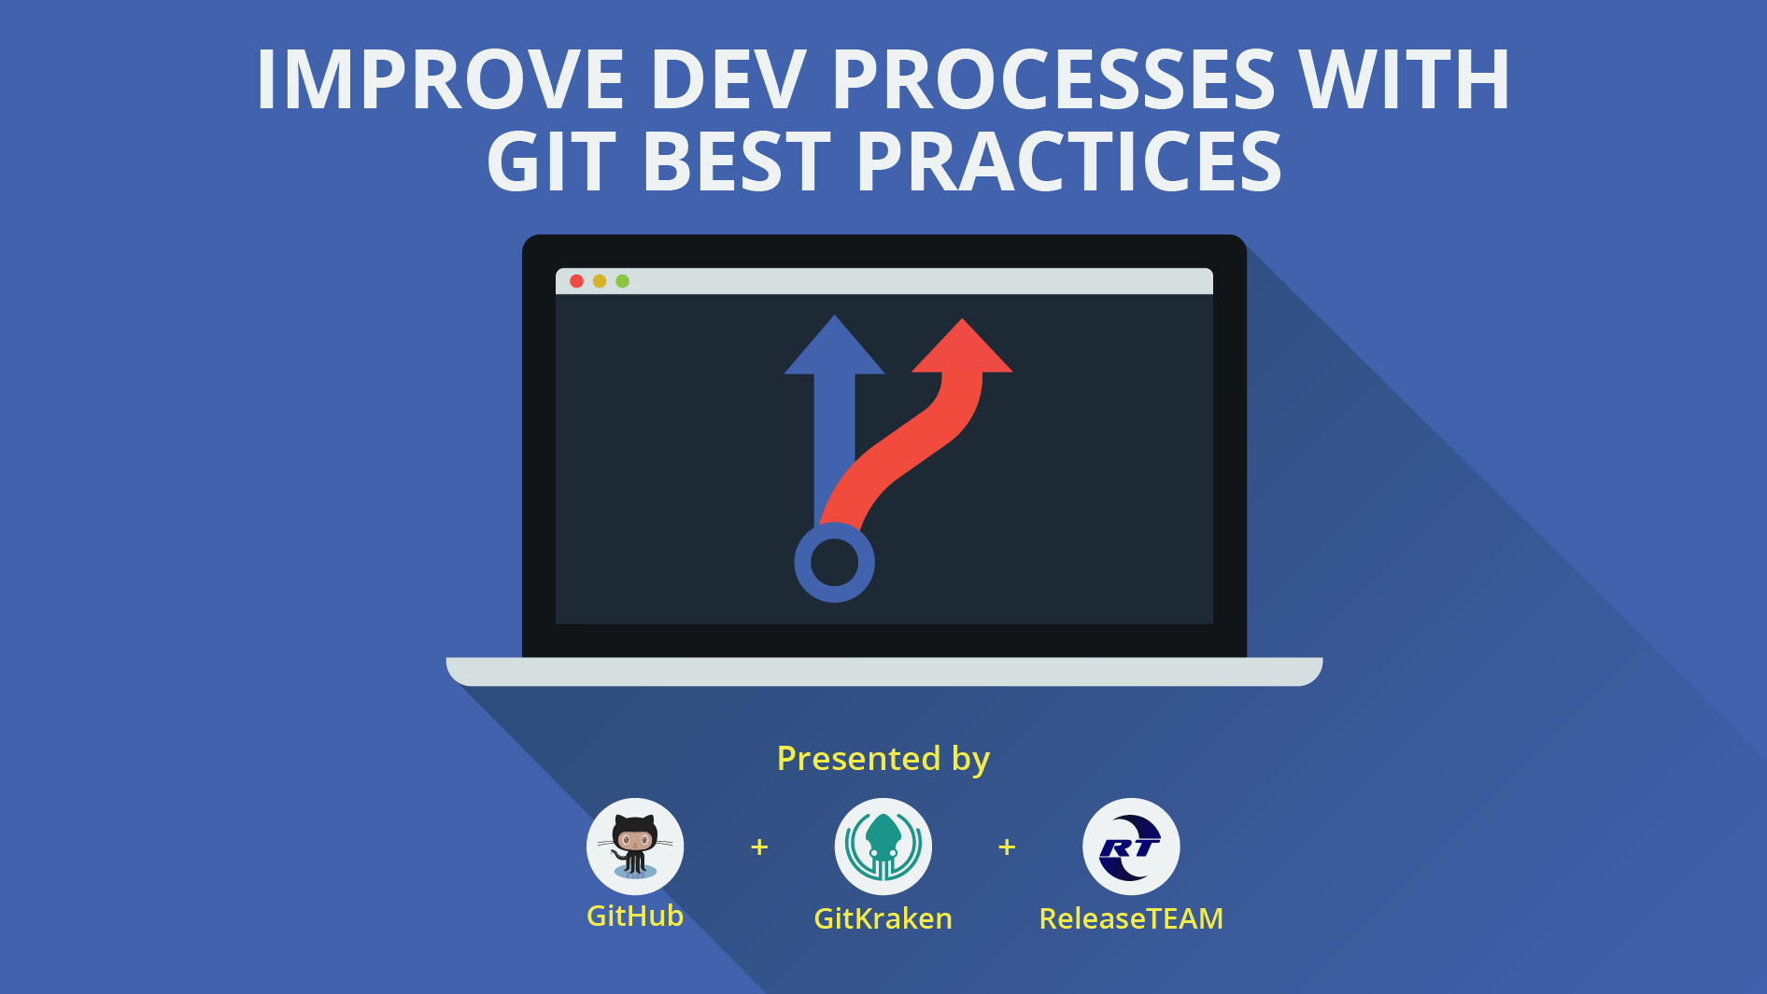

Slide 2



👋 Presenters
Jonathan Silva
Training and
Content Director
@gitkraken
Christian Weber
Senior Solutions Engineer
@github

Slide 3
📝 Webinar Agenda:
Housekeeping
Gitflow
GitKraken example
GitHub Flow and Forking
GitHub example
Pull requests
Pull request in action!

Slide 4

https://github.com/webdog/octicons-png/blob/master/black/mark-github.png?raw=true
💻 What we’ll be using:
gitkraken.com
github.com

Slide 5
Gitflow

Slide 6

📚 Original Source by Vincent Driessen (2010)
https://nvie.com/posts/a-successful-git-
branching-model/

Slide 7
Project’s branches
master
develop

Slide 8
Project’s supporting branches
master
Your “production ready” code
Lives forever

Slide 9
Project’s supporting branches
develop
Your “working” code
Lives forever

Slide 10
Project’s supporting branches
feature
release
hotfix

Slide 11
Project’s supporting branches
feature
For new functionality
Branches off of develop

Slide 12
Project’s supporting branches
release
For preparing next version of product
Branches off of develop

Slide 13
Project’s supporting branches
hotfix
For fast patches to production
Branches off of master

Slide 14

master

Slide 15

master
develop

Slide 16
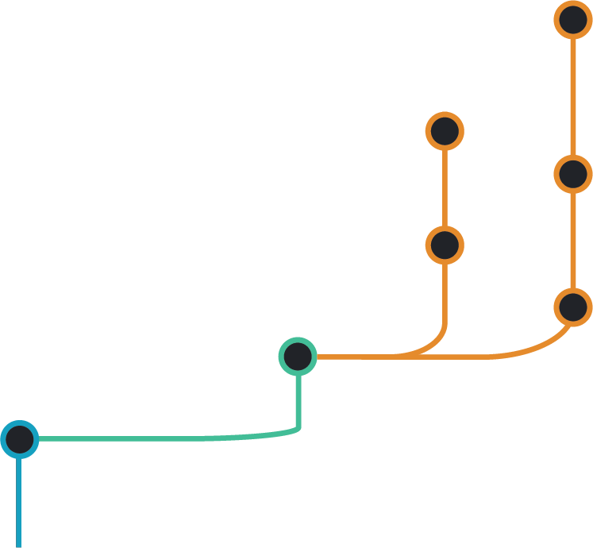
master
develop
feature
feature 2
feature 1

Slide 17
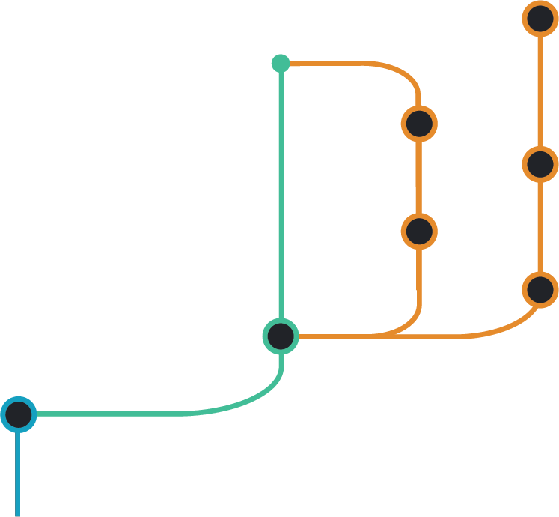
master
develop
feature
feature 2
feature 1

Slide 18
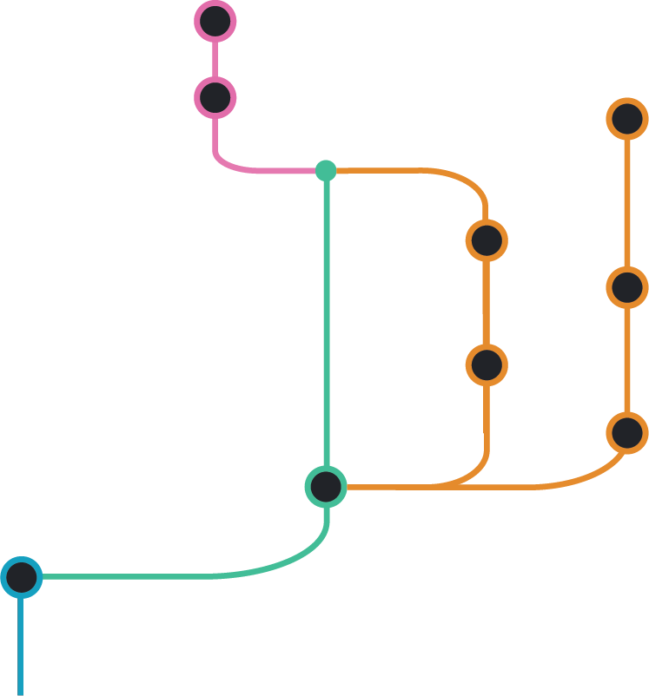
master
develop
feature
release
release v1.0

Slide 19
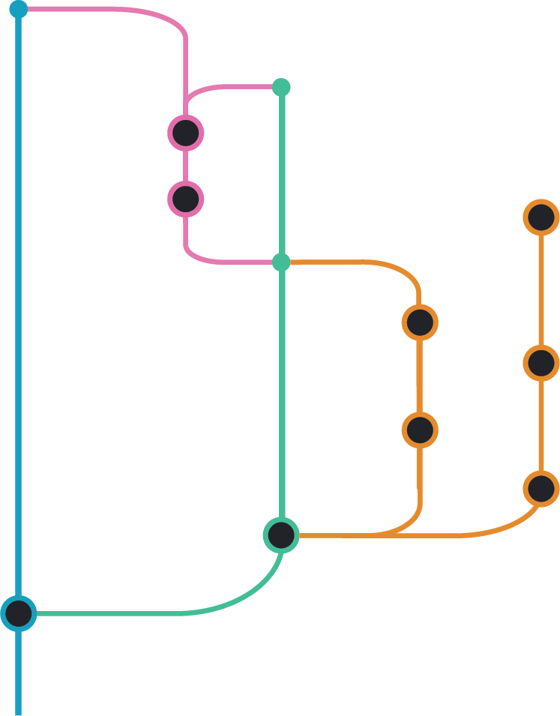
master
develop
feature
release

Slide 20
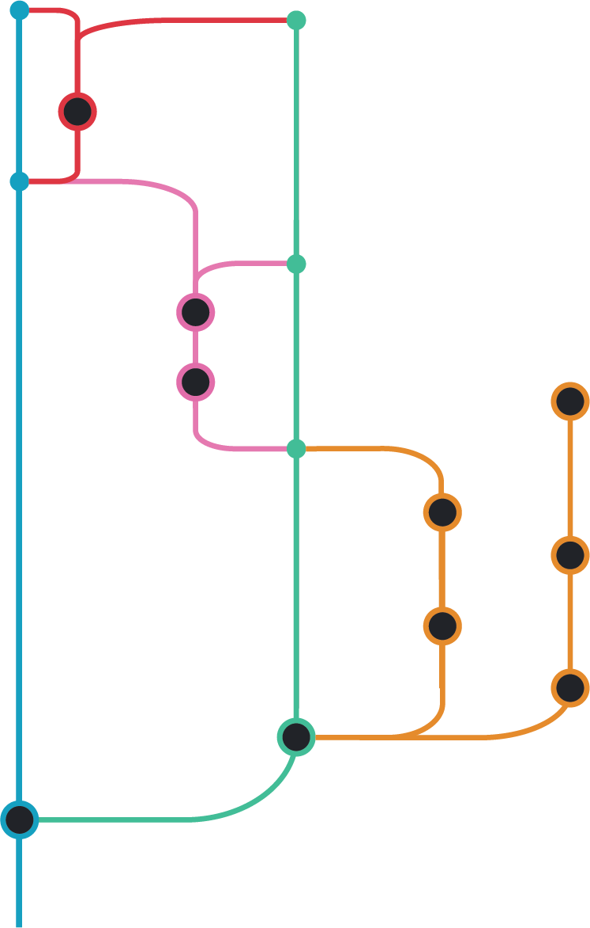
master
develop
feature
release
hotfix
hotfix

Slide 21
Gitflow summary
Branch Name | Created from: | Merges back into:
develop | master | -
feature | develop | develop
release | develop | master and develop
hotfix | master | master and develop

Slide 22
Gitflow alternatives
GitHub Flow
Single branch variations
Notes:
Show PR creation in GitHub and in GK

Slide 23
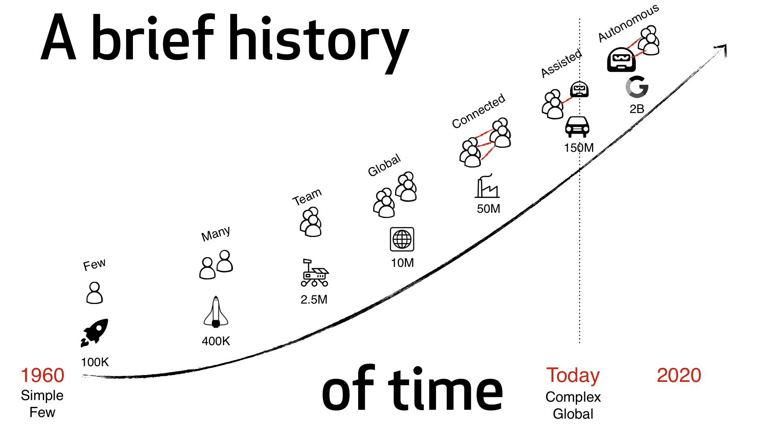
Notes:
Coding has gone from a relatively simple, isolated task to a very complex, globally connected exercise in group and projectment. All these eras, of course, had very good reasons why it was organized this way, why collaboration on a global scale became necessary and what the next phases logically look like.
Let’s now look at how companies transform. This transformation is one from closed systems and frameworks to open systems and frameworks. [click]
Apollo 11 Rocket team lead by Margaret Hamilton— 100k lines of code - open sourced on GitHub today.
Lunar landing -2.5 million
Firefox - 10 million lines of code, things started going global
2005 - Git, Linus Torvald
2016 Ford F-150 pickup: 150 million lines of code, a data center on wheels
Google base - 2B lines of code
source: http://www.informationisbeautiful.net/visualizations/million-lines-of-code/

Slide 24
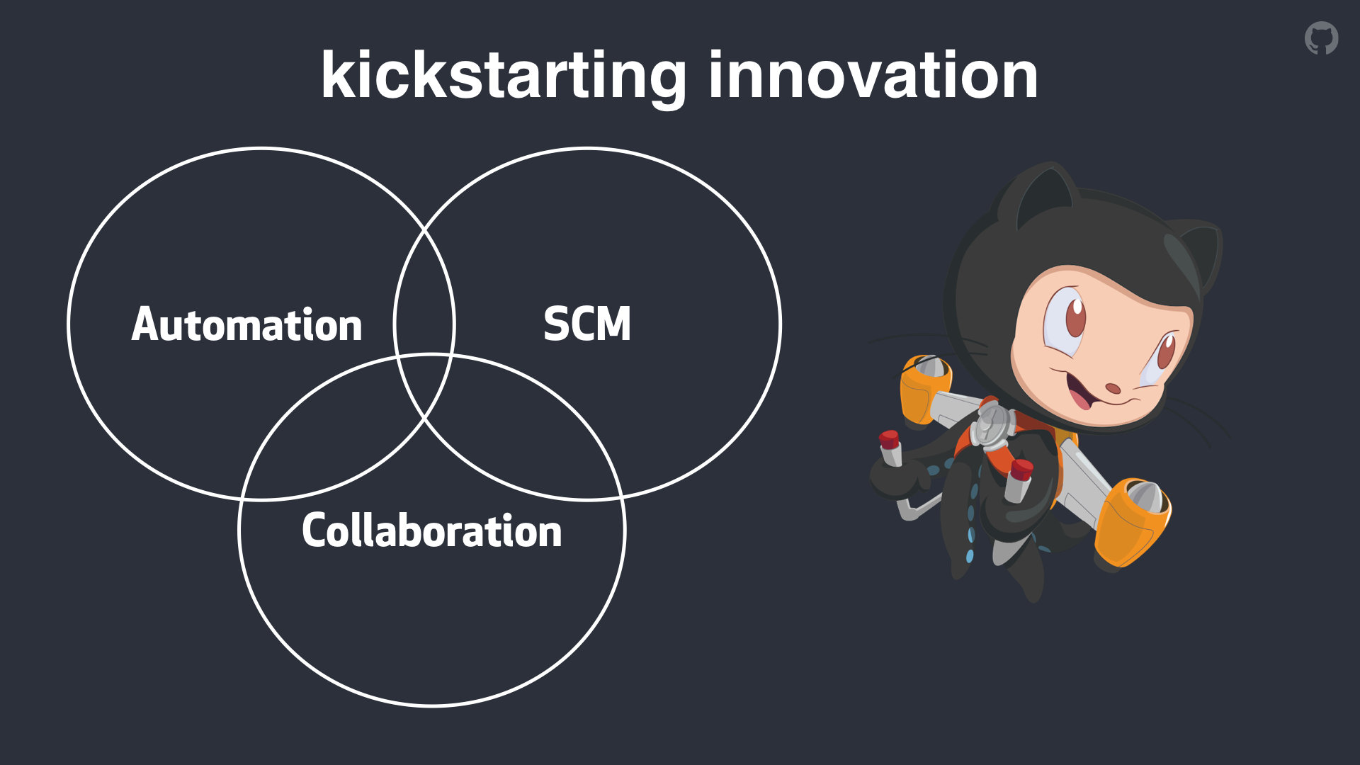

Slide 25
GitHub Flow and Forking

Slide 26
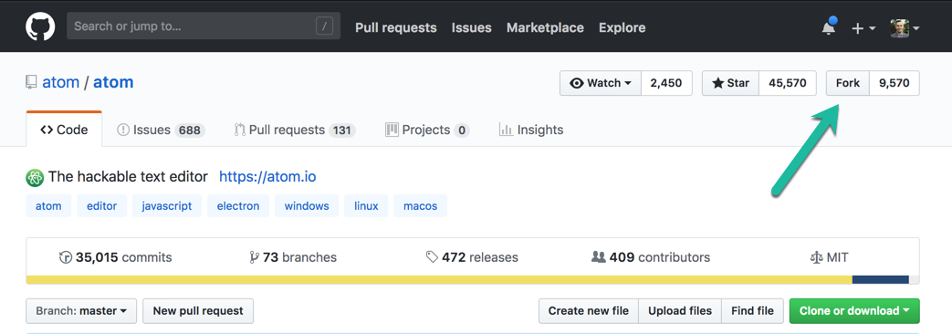

Slide 27
Cloning vs Forking

Slide 28
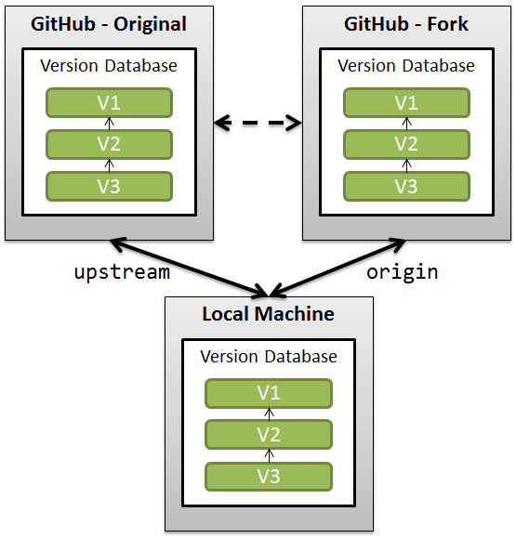
Sandbox environment
Innovate + Experiment
Move quickly

Slide 29
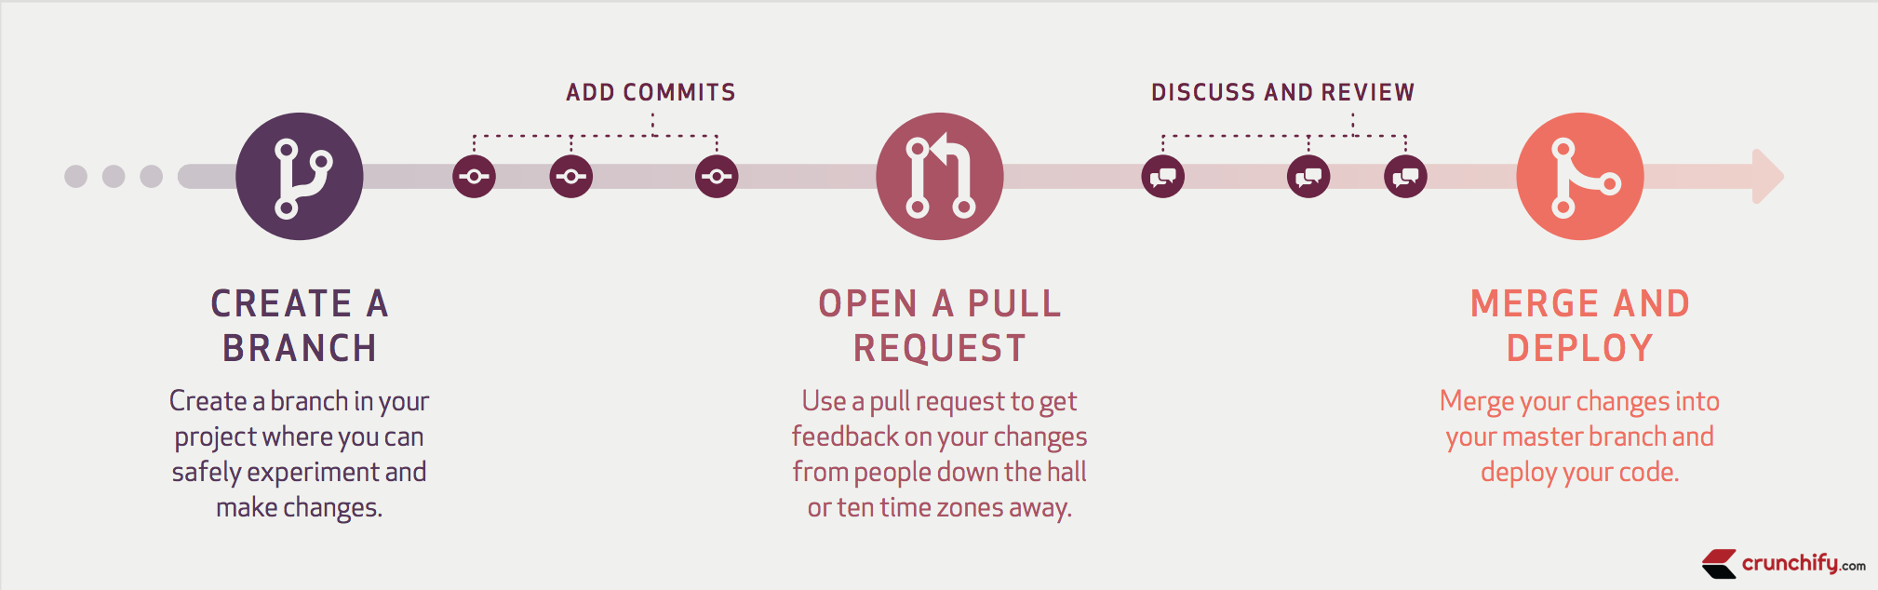
GitHub Flow

Slide 30

Pull Request
Project
Project Fork
Pull
Push
Pull

Slide 31
Pull Requests

Slide 32
Why use Pull Requests?
Increase Code Quality
Automate the Boring Stuff
Empower your people and community

Slide 33

Pull Request Creation
README and CONTRIBUTING
PR titles are read by humans
Small, iterative PRs will save your a**
/cc the Right People for

Slide 34
Pull Request Reviews
Don’t be ‘that person’; offer help
Respond quickly, keep things moving
Don’t fix mistakes, ask author to fix them

Slide 35
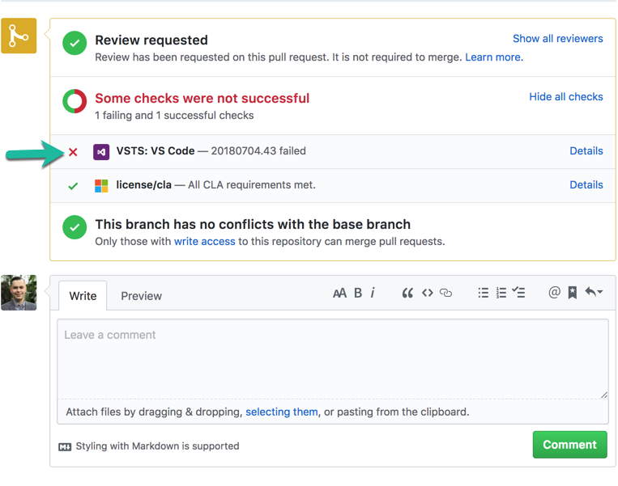
Protecting your collaboration

Slide 36
Q&A

Slide 37

THANK YOU!
GitHub
GitKraken
ReleaseTEAM

